Slide 1
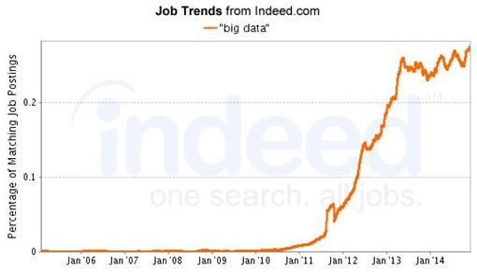
Finding a Career in
Big Data & Analytics.
Jeremy Verbit
Senior Product Manager,
Data & Analytics
HookLogic, Inc.
MMSTC Class of 2005

Slide 2
Overview.
HookLogic
What We Do
How We’re Innovating
Big Data & Analytics
Overview
Job Positions
Technologies, Product Management, and Agile Methodology
College Courses To Take
How I Got Here
Education
Professional Life
Advice
College
Real World
Continued Studies
Q & A

Slide 3
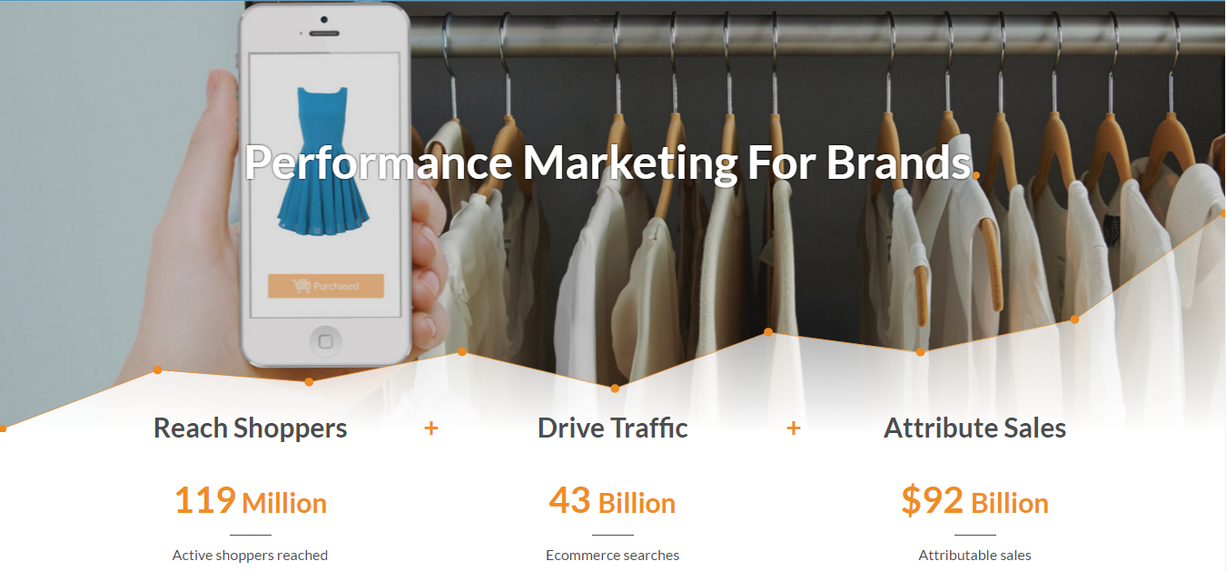

Slide 4
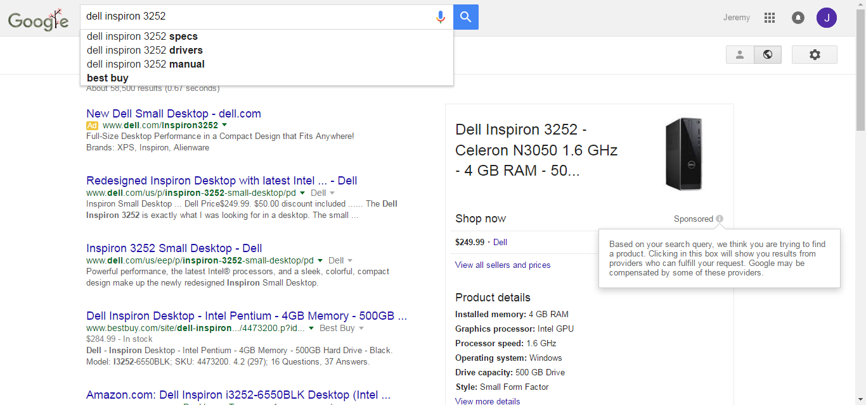
What We Do.

Slide 5
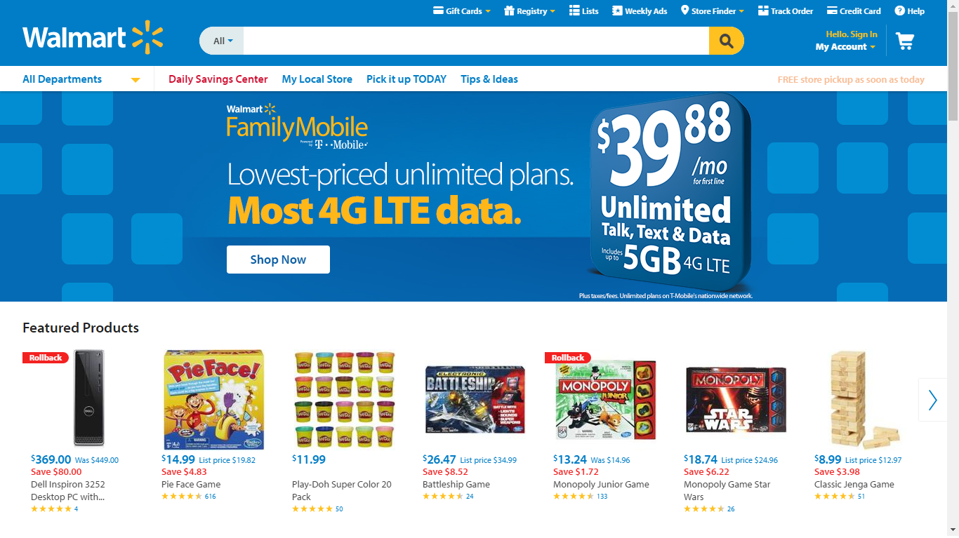
What We Do.

Slide 6
How We’re Innovating.

Slide 7
Big Data & Analytics.
Job Positions, Technologies, College Courses

Slide 8
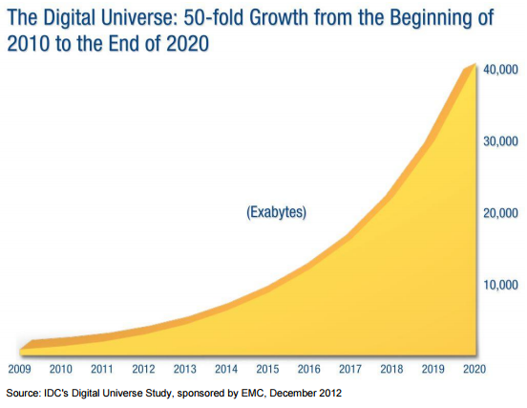
Overview.

Slide 9
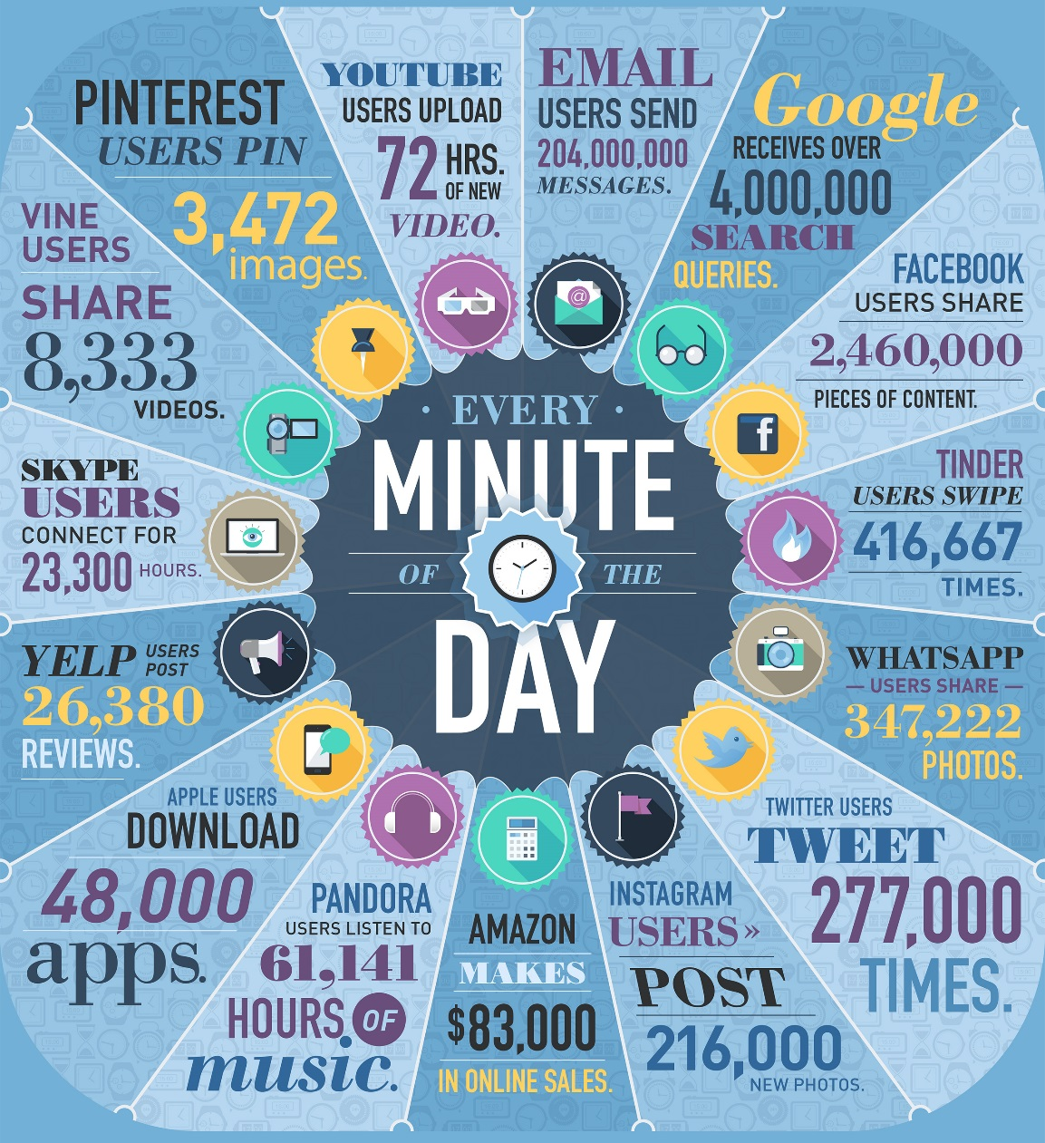
Overview.

Slide 10
Overview.

Slide 11
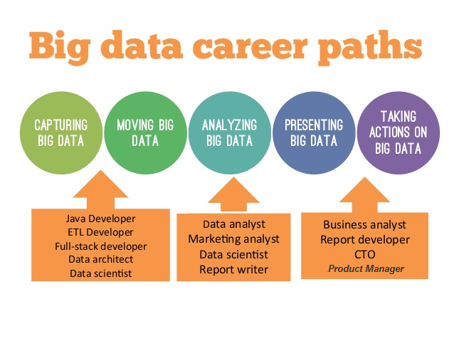
Job Positions.

Slide 12
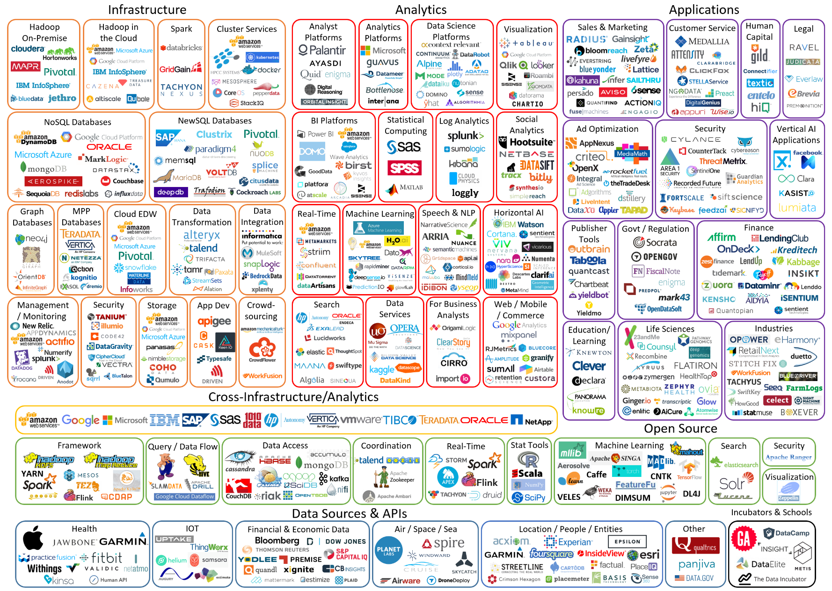
Technologies.

Slide 13
Technologies.

Slide 14
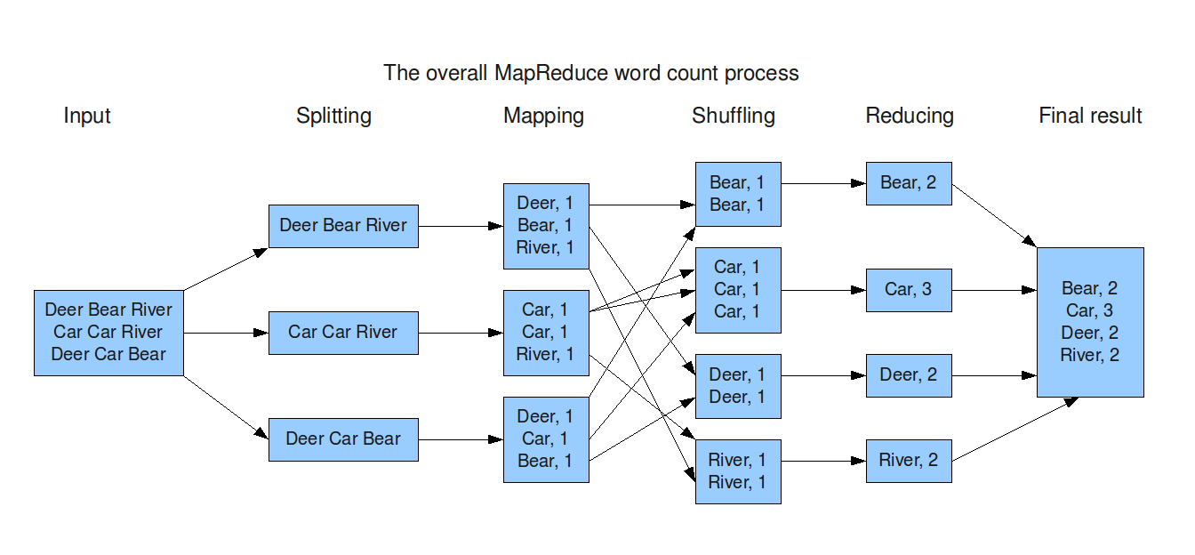
Technologies.

Slide 15
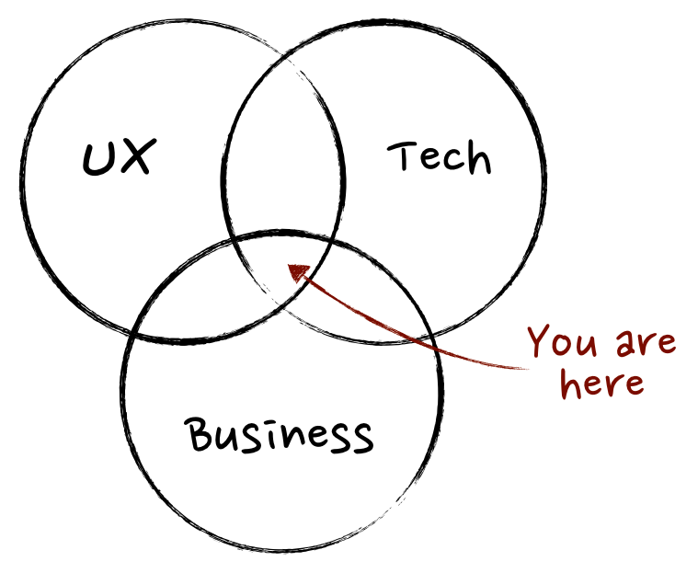
Product Management.
Collect Customer Input > Plan Product Roadmap > Write Product Requirement Documents > Work with Engineers to Ensure Design Meets Business Requirements > Hand off to Project Management for Current Sprint

Slide 16
Agile Methodology.

Slide 17
College Courses To Take.
Major:
Computer Science
Major:
Statistics
Industrial & Operations Eng
Minor:
Computer Science
Major:
Business / Marketing
Industrial & Operations Eng
Minor:
Computer Science

Slide 18
How I Got Here.
Education, Professional Life

Slide 19
Education.
High School
MMSTC / Cousino
College
University of Michigan – Ann Arbor
Physics: College of Literature, Science, and Arts (LSA)
Computer Science: College of Engineering (COE)
Minor
Industrial & Operations Engineering: COE
Major
Entrepreneurship: COE / Ross School of Business (RSB)
Certificate
Work
Computer Aided Engineering Network (CAEN) Hotline

Slide 20
Professional Life.
CONTAX, Inc (Chicago) – 6 months
Enterprise Resource Planning Consultant
eSearchVision (Ann Arbor) – 6 months
Search Engine Marketing Account Manager
MyBuys (Ann Arbor) – 4 years
Optimization Analyst
Product Manager
Senior Product Manager
HookLogic (Ann Arbor) – 7 months
Senior Product Manager, Data & Analytics

Slide 21
Advice.
College, Real World, Continued Studies

Slide 22
College.
Sign up for too many classes, then drop those that don’t feel right.
Make a plan to get your questions answered:
Office hours
Peer mentoring clinics
Make friends in class
Rent a house
Find a part-time job that allows time for homework on the job

Slide 23
Real World.
Track & project spending & bank balances
Tracking: Mint.com
Projecting: Excel
Push for raises
Salary.com
Glassdoor.com
Save & invest
401k, Roth IRA
Betterment.com, Wealthfront.com, Vanguard

Slide 24
Continued Studies.
Intro to Programming (One Generic Language)
Python
Udacity.com: Introduction to Programming
SQL
Database Management Systems (3rd edition) - by Raghu Ramakrishnan and Johannes Gehrke
Learn to Build a Dynamic Website (HTML, CSS, PHP, MySQL)
Sitepoint.com: Build Your Own Website The Right Way Using HTML & CSS, 3rd Edition
R
Coursera.com: Data Science Specialization (Johns Hopkins)
Hadoop: Hive / Spark / Oozie
Cousera.com: Big Data Specialization (U of California – San Diego)

Slide 25
Open Q&A.
Classes, Social Life, Happiness, Money, Work . . .

